Slide 1
Manufacturing Task Tracker (MTT) 2017 Updates - Phase 1 February, 2017

Slide 2
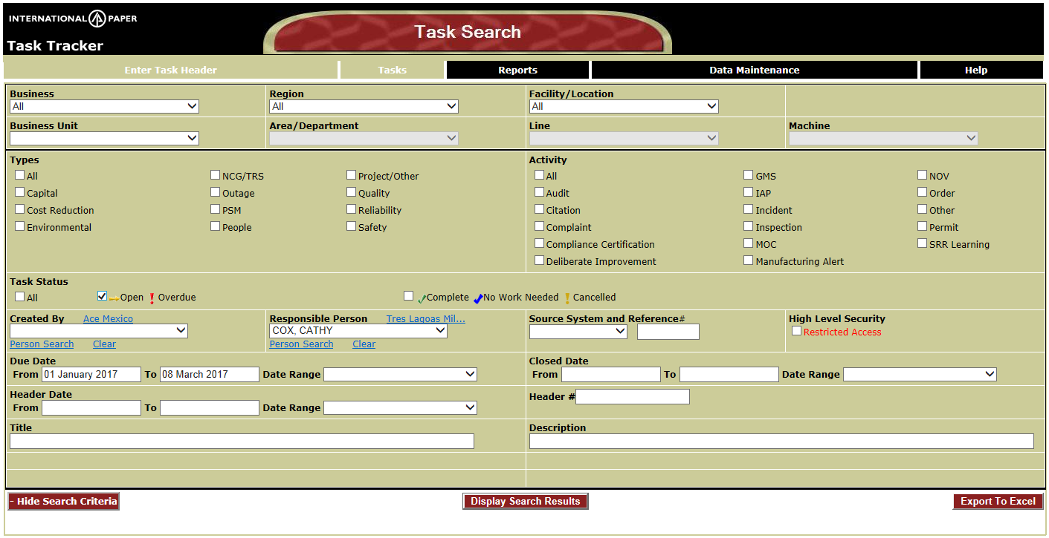
Task Search Page
On startup of MTT, Task Search filter page will be displayed
No query will automatically be performed
Due Date will default to Year to Date range + 1 month
To get task list…..Click Display Search Results button
Notes:
An image of the MTT screen would be here. Also, if you are going to have a website with information about the MTT (faqs), this would be a good page to link to it.

Slide 3
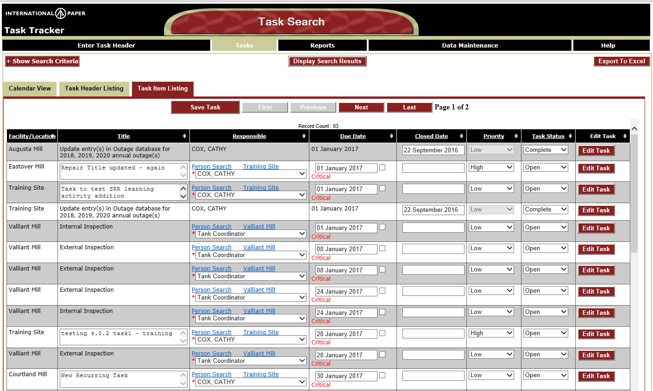
Task Search Results
Search results will default to the Task Item Listing tab
Calendar and Task Header Listing Views are still available for viewing
Notes:
An image of the MTT screen would be here. Also, if you are going to have a website with information about the MTT (faqs), this would be a good page to link to it.

Slide 4
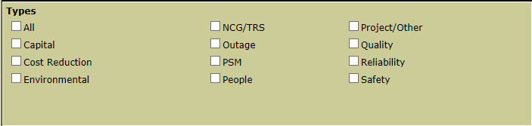
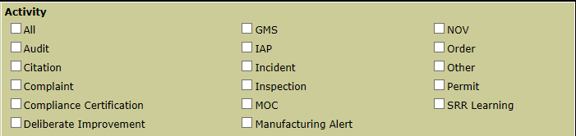
New Activities and Types
New Types – (PSM, NCG/TRS) New Activities – Deliberate Improvement, IAP,
Manufacturing Alert
* New type manager roles will be added (PSM Coordinator and NCG/TRS Coordinator)
Notes:
An image of the MTT screen would be here. Also, if you are going to have a website with information about the MTT (faqs), this would be a good page to link to it.

Slide 5
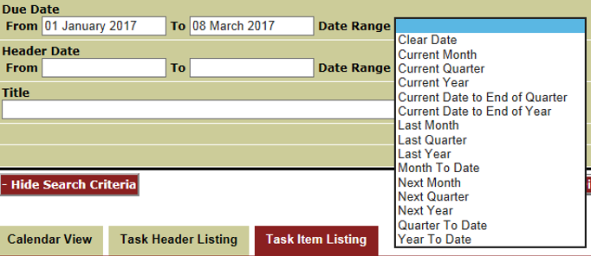
Date Ranges
New Future Date Ranges Added for all Date Range dropdowns
Notes:
An image of the MTT screen would be here. Also, if you are going to have a website with information about the MTT (faqs), this would be a good page to link to it.

Slide 6
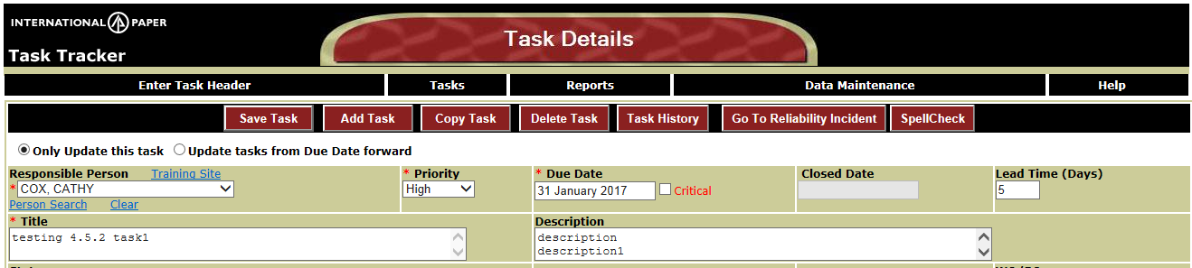
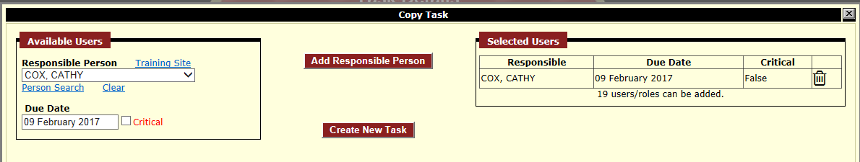
Copy Task
Click Copy button while viewing the task you want to duplicate
Recurrence parameters and Attachments will be copied
New Tasks will be created on same header as the copied task
Select responsible person and Due Date – Click Add Responsible Person
Up to 20 people can be added per page – Trash can icon will delete a line if someone needs to be removed
Click Create New Task for all tasks to be created for all Selected Users

Slide 7
Delete Task
Click Delete Task button to delete task being viewed
All attachments, comments, subtasks, subsequent templates will be deleted
A warning message will be displayed where you can OK or Cancel the delete
Facility Admin and Task Creator has this access

Slide 8
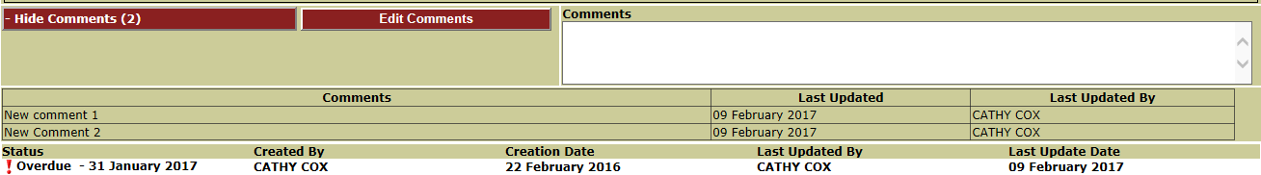
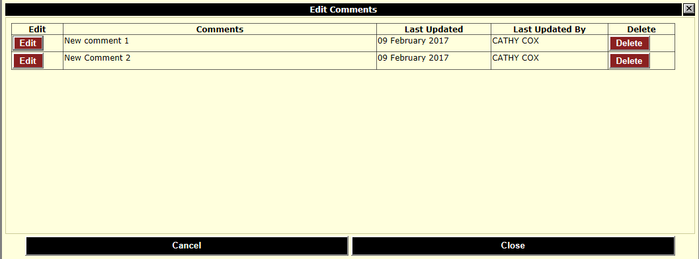
Update/Delete Comments
Click Edit Comments Button to edit or delete a comment
Facility Admin and comment creator has this access
Click Edit Button to change the comment text
Click Delete Button to delete comment completely

Slide 9
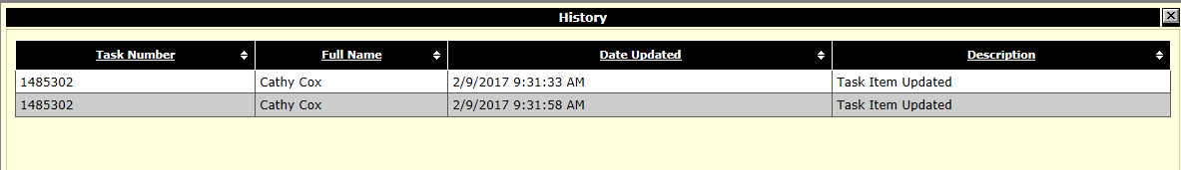
Task History
Click Task History Button to display History records
History will show Task Creation, Task updates, Responsible user
Change, Due Date change
History records will display on Popup Window

Slide 10
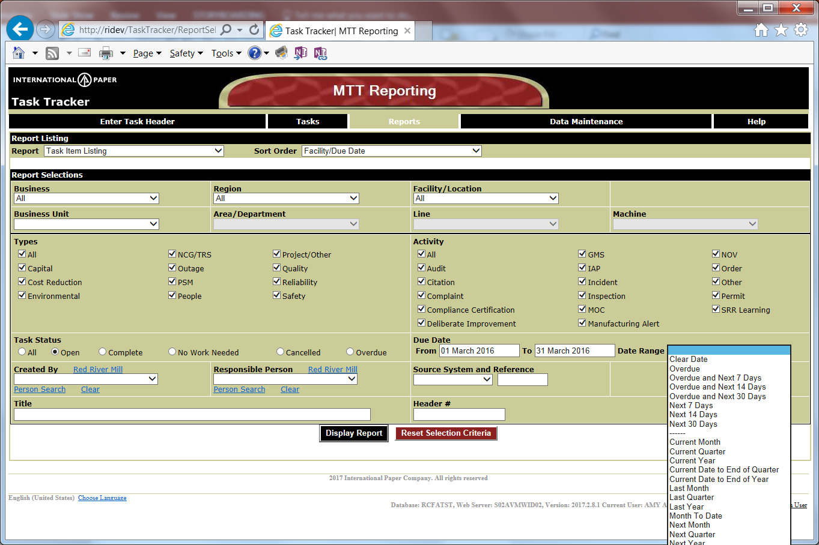
Report Changes - Filter changes
Reports Task Item Listing(s), Task Report by Mill, Task Status Report
Added Header Number
Task Status (Open) now has Date Range
Notes:
An image of the MTT screen would be here. Also, if you are going to have a website with information about the MTT (faqs), this would be a good page to link to it.

Slide 11
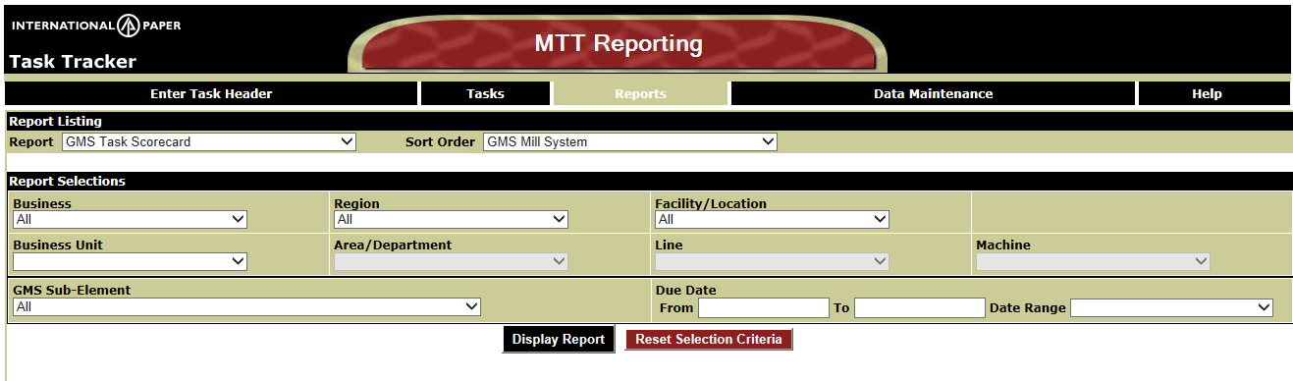
Report Changes - Filter changes
Reports GMS Listing
Added Date Range
Tasks will be returned with Due Dates in the Date Range
Notes:
An image of the MTT screen would be here. Also, if you are going to have a website with information about the MTT (faqs), this would be a good page to link to it.

Slide 12
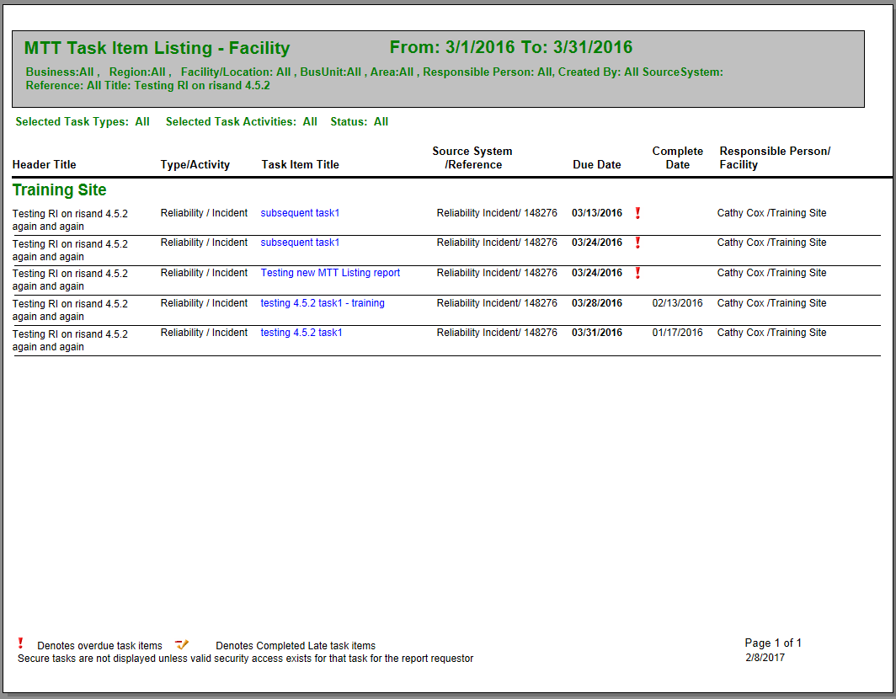
Report Changes – Task Item Listing Layout
Removed Header and Item Numbers
Link to MTT Task Detail (Task Item Title)
Notes:
An image of the MTT screen would be here. Also, if you are going to have a website with information about the MTT (faqs), this would be a good page to link to it.

Slide 13
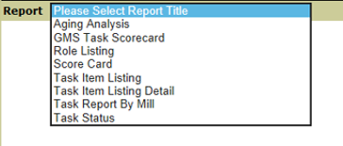
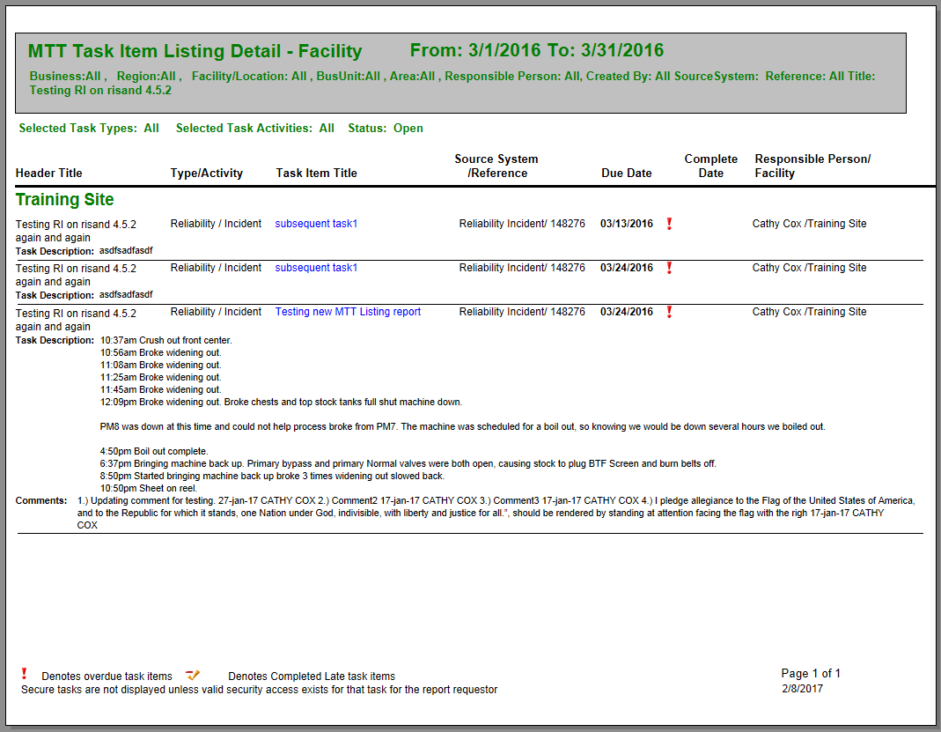
Report Changes
New - Task Item Listing Detail Report
Report contains
Task Description
Comment Text
Comment Date
Comment Created By
Link to MTT Task Item (Task Item Title)
Notes:
An image of the MTT screen would be here. Also, if you are going to have a website with information about the MTT (faqs), this would be a good page to link to it.

